Slide 1


Slide 2
Spring Overview
Spring Architecture
Spring HelloWorld Example
Spring Functions

Slide 3
Spring Overview
What is Spring?
Spring framework is an open source Java platform and it was initially written by Rod Johnson and was first released under the Apache 2.0 license in June 2003.
It is an extremely powerful Inversion of control(IoC) framework to help decouple your project components’ dependencies

Slide 4
Spring Overview
Benefits of Using Spring Framework:
Lightweight
Using POJO
Modular fashion
Easy to test
Easy to develop web application with Spring MVC
Provide a consistent transaction management interface
Easy to integrate with other frameworks such as: Struts, JSF, Hibernate,…

Slide 5
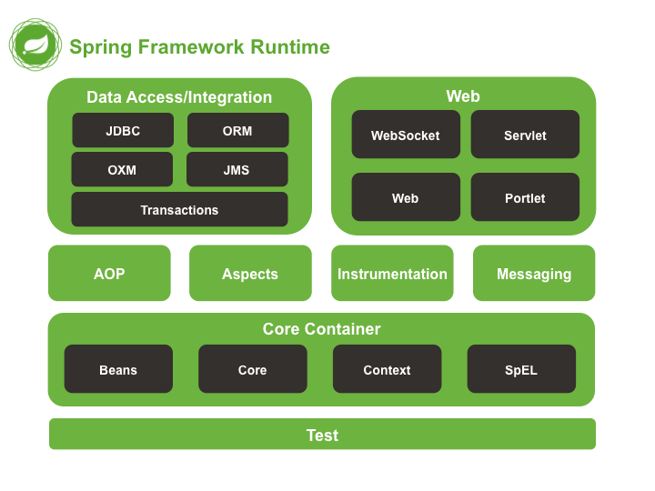
Spring Architecture

Slide 6
Spring HelloWorld Example
Create Maven Project
Update pom.xml to get Spring Core libs
Create HelloWorld.java file as Spring Bean
Create SpringBeans.xml to declare Spring Bean. This file is in src/main/resource
Create App.java class to process the HelloWorld bean.

Slide 7
Spring HelloWorld Example
Update pom.xml :
<!-- Spring dependencies -->
<dependency>
<groupId>org.springframework</groupId>
<artifactId>spring-core</artifactId>
<version>${spring.version}</version>
</dependency>
<dependency>
<groupId>org.springframework</groupId>
<artifactId>spring-context</artifactId>
<version>${spring.version}</version>
</dependency>

Slide 8
Spring HelloWorld Example
HelloWorld.java
public class HelloWorld {
private String name;
public void setName(String name) {
this.name = name;
}
public void printHello() {
System.out.println("Spring says : Hello ! " + name);
}
}

Slide 9
Spring HelloWorld Example
SpringBeans.xml
<beans xmlns="http://www.springframework.org/schema/beans"
xmlns:xsi="http://www.w3.org/2001/XMLSchema-instance"
xsi:schemaLocation="http://www.springframework.org/schema/beans
http://www.springframework.org/schema/beans/spring-beans-4.0.xsd">
<bean id="helloBean" class="com.vietsci.HelloWorld">
<property name="name" value="MY NAME in SPRINGBEAN.XML file" />
</bean>
</beans>

Slide 10
Spring HelloWorld Example
App.java
public class App {
public static void main(String[] args) {
@SuppressWarnings("resource")
ApplicationContext context = new ClassPathXmlApplicationContext(
"SpringBeans.xml");
HelloWorld obj = (HelloWorld) context.getBean("helloBean");
obj.printHello();
}
}

Slide 11
Spring Functions
Spring Ioc Container
Spring Bean
Spring Dependency Injection
Spring Configuration
Spring Transaction Management
Spring AOP

Slide 12
Spring - IoC Containers
The Spring container is at the core of the Spring Framework.
The container will create the objects, wire them together, configure them, and manage their complete lifecycle from creation till destruction.
The Spring container uses dependency injection (DI) to manage the components that make up an application
These objects are called Spring Beans which we will discuss in next chapter.

Slide 13
Spring - IoC Containers
2 types of container:
BeanFactory
ApplicationContext
BeanFactory: provides the configuration framework and basic functionality
ApplicationContext: is sub-interface of BeanFactory. It is added more enterprise-specific functionality

Slide 14
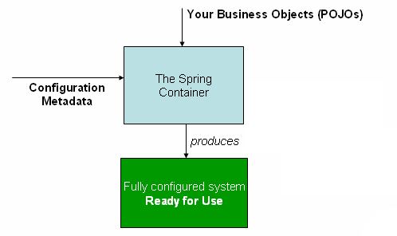
Spring - IoC Containers

Slide 15
Spring Bean
Bean Definition
Bean Scope
Bean Life Cycle
Bean Definition Inheritance

Slide 16
Bean Definition
The objects that form the backbone of your application and that are managed by the Spring IoC container are called beans.
A bean is an object that is instantiated, assembled, and otherwise managed by a Spring IoC container.
A Spring IoC container manages one or more beans.
These beans are created with the configuration metadata that you supply to the container, for example, in the form of XML <bean/> definitions.

Slide 17
Bean Definition
Within the container itself, these bean definitions are represented as BeanDefinition objects, which contain (among other information) the following metadata:

Slide 18
Bean Definition
Properties | Description
class | This attribute is mandatory and specify the bean class to be used to create the bean.
name | This attribute specifies the bean identifier uniquely. In XML-based configuration metadata, you use the id and/or name attributes to specify the bean identifier(s).
scope | This attribute specifies the scope of the objects created from a particular bean definition and it will be discussed in bean scopes chapter.
constructor-arg | This is used to inject the dependencies and will be discussed in next chapters.
properties | This is used to inject the dependencies and will be discussed in next chapters.
autowiring mode | This is used to inject the dependencies and will be discussed in next chapters.
lazy-initialization mode | A lazy-initialized bean tells the IoC container to create a bean instance when it is first requested, rather than at startup.
initialization method | A callback to be called just after all necessary properties on the bean have been set by the container. It will be discussed in bean life cycle chapter.
destruction method | A callback to be used when the container containing the bean is destroyed. It will be discussed in bean life cycle chapter.

Slide 19
Bean Definition
Spring Configuration Metadata is defined in one of the following config types:
XML based configuration file.
Annotation-based configuration
Java-based configuration
Template of XML based configuration:

Slide 20
Bean Definition
<?xml version="1.0" encoding="UTF-8"?>
<beans xmlns="http://www.springframework.org/schema/beans"
xmlns:xsi="http://www.w3.org/2001/XMLSchema-instance"
xsi:schemaLocation="http://www.springframework.org/schema/beans
http://www.springframework.org/schema/beans/spring-beans-4.0.xsd">
<!-- A simple bean definition -->
<bean id="..." class="...">
<!-- collaborators and configuration for this bean go here -->
</bean>
<!-- A bean definition with lazy init set on -->
<bean id="..." class="..." lazy-init="true">
<!-- collaborators and configuration for this bean go here -->
</bean>
<!-- A bean definition with initialization method -->
<bean id="..." class="..." init-method="...">
<!-- collaborators and configuration for this bean go here -->
</bean>
<!-- A bean definition with destruction method -->
<bean id="..." class="..." destroy-method="...">
<!-- collaborators and configuration for this bean go here -->
</bean>
<!-- more bean definitions go here -->
</beans>

Slide 21
Bean Scope
When defining a <bean> in Spring, you have the option of declaring a scope for that bean.
Beans can be defined to be deployed in one of a number of scopes: out of the box, the Spring Framework supports five scopes, three of which are available only if you use a web-aware ApplicationContext.

Slide 22
Bean Scope
Scope | Description
singleton | (Default) Scopes a single bean definition to a single object instance per Spring IoC container.
prototype | Scopes a single bean definition to any number of object instances.
request | Scopes a single bean definition to the lifecycle of a single HTTP request; that is, each HTTP request has its own instance of a bean created off the back of a single bean definition. Only valid in the context of a web-aware Spring ApplicationContext.
session | Scopes a single bean definition to the lifecycle of an HTTP Session. Only valid in the context of a web-aware Spring ApplicationContext.
global session | Scopes a single bean definition to the lifecycle of a global HTTP Session. Typically only valid when used in a portlet context. Only valid in the context of a web-aware Spring ApplicationContext.
application | Scopes a single bean definition to the lifecycle of a ServletContext. Only valid in the context of a web-aware Spring ApplicationContext.

Slide 23
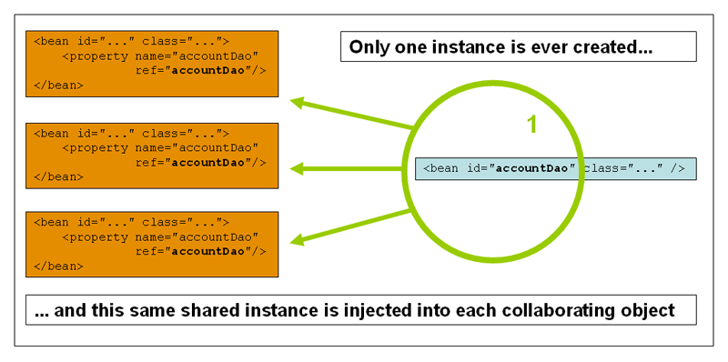
Bean Scope
The singleton scope

Slide 24
Bean Scope
Define this scope bean configuration file:
<!-- A bean definition with singleton scope -->
<bean id="..." class="..." scope="singleton">
</bean>
Example of Singleton Scope

Slide 25
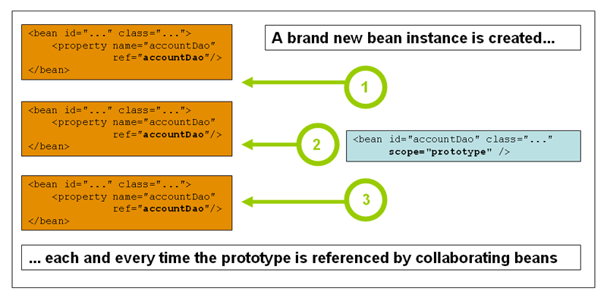
Bean Scope
The prototype scope

Slide 26
Bean Scope
Define this scope bean configuration file:
<!-- A bean definition with prototype scope -->
<bean id="..." class="..." scope="prototype">
</bean>
Example of Prototype Scope

Slide 27
Bean Life Cycle
Initialization callbacks
In config file
<bean id="exampleBean" class="examples.ExampleBean" init-method="init"/>
In Bean class
public class ExampleBean {
public void init() {
// do some initialization work
}
}

Slide 28
Bean Life Cycle
Destruction callbacks
In config file
<bean id="exampleBean" class="examples.ExampleBean" destroy-method="destroy"/>
In Bean class
public class ExampleBean {
public void destroy() {
// do some destroy work
}
}

Slide 29
Bean Definition Inheritance
A bean definition can contain a lot of configuration information, including constructor arguments, property values, and container-specific information such as initialization method, static factory method name, and so on.
A child bean definition inherits configuration data from a parent definition. The child definition can override some values, or add others, as needed.
When you use XML-based configuration metadata, you indicate a child bean definition by using the parent attribute, specifying the parent bean as the value of this attribute.

Slide 30
Bean Definition Inheritance
<bean id="inheritedTestBean" abstract="true"
class="org.springframework.beans.TestBean">
<property name="name" value="parent"/>
<property name="age" value="1"/>
</bean>
<bean id="inheritsWithDifferentClass"
class="org.springframework.beans.DerivedTestBean"
parent="inheritedTestBean" init-method="initialize">
<property name="name" value="override"/>
<!-- the age property value of 1 will be inherited from parent -->
</bean>

Slide 31
Bean Definition Inheritance
Bean Definition Template:
Look like Java abstract class or interface
While defining a Bean Definition Template, you should not specify class attribute and should specify abstract attribute with a value of true as shown below:
<!-- this is Bean Definition Template -->
<bean id="profile" abstract="true">
<property name="rank" value="Giáo sư" />
</bean>
<!-- this is Bean Inheritance and also is the parent bean of other-->
<bean id="fatherBean" class="com.vietsci.Father" parent="profile">
<property name="familyName" value="Nguyễn" />
<property name="givenName" value="Lân" />
</bean>

Slide 32
Spring Dependency Injection
What is Dependency Injection?
Why use Dependency Injection?
Dependency Injection Type.

Slide 33
Spring Dependency Injection
You try to make classes in Java program as independent as possible so that you can be easily to:
reuse
test
update
these classes.
Dependency Injection (DI) (or sometime called wiring) is a software design pattern that implements inversion of control (IoC) for resolving dependencies

Slide 34
Spring Dependency Injection
Dependency Injection helps in gluing these classes together and same time keeping them independent.
Explained code:

Slide 35
Spring Dependency Injection
Standard code (Normal code)
public class Payment {
private Order order;
public Payment() {
order = new Order();
}
}
Inversion of Control code:
public class Payment {
private Order order;
public Payment(Order order) {
this.order = order;
}
}

Slide 36
Spring Dependency Injection
Dependency Injection Type
DI Type | Description
Constructor-based | Constructor-based DI is accomplished when the container invokes a class constructor with a number of arguments, each representing a dependency on other class.
Setter-based | Setter-based DI is accomplished by the container calling setter methods on your beans after invoking a no-argument constructor or no-argument static factory method to instantiate your bean.

Slide 37
Spring Dependency Injection
Example of Constructor-based DI
Example of Setter-based DI

Slide 38
Spring - Injecting Inner Beans
What is inner beans?
They are beans that are defined within the scope of another bean.
A <bean/> element inside the <property/> or <constructor-arg/> elements is called inner bean.

Slide 39
Spring - Injecting Inner Beans
<?xml version="1.0" encoding="UTF-8"?>
<beans xmlns="http://www.springframework.org/schema/beans"
xmlns:xsi="http://www.w3.org/2001/XMLSchema-instance"
xsi:schemaLocation="http://www.springframework.org/schema/beans
http://www.springframework.org/schema/beans/spring-beans-3.0.xsd">
<bean id="outerBean" class="...">
<property name="target">
<bean id="innerBean" class="..."/>
</property>
</bean>
</beans>

Slide 40
Spring - Injecting Collection
We have used value attribute and object references using ref attribute of the <property> tag in your Bean configuration file. Both the cases deal with passing singular value to a bean.
We will pass values like Java Collection types List, Set, Map, and Properties.
Example

Slide 41
Spring - Beans Auto-Wiring
We use <constructor-arg> and <property> elements in XML configuration file to inject (wire) beans in manual way (explicit declaration).
Spring container can help us to do it by autowire mode.
Autowiring Modes are listed below:

Slide 42
Spring - Beans Auto-Wiring
Mode | Description
no | This is default setting which means no autowiring and you should use explicit bean reference for wiring. You have nothing to do special for this wiring. This is what you already have seen in Dependency Injection chapter.
byName | Autowiring by property name. Spring container looks at the properties of the beans on which autowire attribute is set to byName in the XML configuration file. It then tries to match and wire its properties with the beans defined by the same names in the configuration file.
byType | Autowiring by property datatype. Spring container looks at the properties of the beans on which autowire attribute is set to byType in the XML configuration file. It then tries to match and wire a property if its type matches with exactly one of the beans name in configuration file. If more than one such beans exists, a fatal exception is thrown.
constructor | Similar to byType, but type applies to constructor arguments. If there is not exactly one bean of the constructor argument type in the container, a fatal error is raised.
autodetect | Spring first tries to wire using autowire by constructor, if it does not work, Spring tries to autowire by byType.

Slide 43
Annotation Based Configuration
Instead of using XML to describe a bean wiring, you can use annotations to do it from Spring 2.5.
Annotation injection is performed before XML injection, thus the latter configuration will override the former for properties wired through both approaches.
To use annotations, you need to enable this function of Spring, by put snipet below to XML config file:
<context:annotation-config/>

Slide 44
Annotation Based Configuration
Annotation | Description
@Required | The @Required annotation applies to bean property setter methods. It indicates that the affected bean property must be populated in XML configuration file at configuration time otherwise the container throws a BeanInitializationException exception.
@Autowired | The @Autowired annotation can apply to bean property setter methods, non-setter methods, constructor and properties.
@Qualifier | The @Qualifier annotation along with @Autowired can be used to remove the confusion by specifiying which exact bean will be wired.
JSR-250 | Spring supports JSR-250 based annotations which include @Resource, @PostConstruct and @PreDestroy annotations.

Slide 45
Java Based Configuration
We can use Annotation in Java class to declare Spring Beans and other information instead of using XML config.
Most important Java-based annotations:
@Configuration: indicates that the class can be used by the Spring IoC container as a source of bean definitions
@Bean: tells Spring that a method annotated with @Bean will return an object that should be registered as a bean in the Spring application context
@Import: allows for loading @Bean definitions from another configuration class

Slide 46
THANK YOU

